Slide 1

International Business Valuation Conference
Milano, Bocconi University
January 22, 2024
Early Stage Valuation: Critical Issues
Antonella Puca, CPA/ABV, CFA
BlueVal
Organized by: Organismo Italiano di Valutazione (OIV)

Slide 2

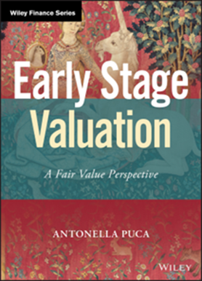

Antonella Puca, CPA/ABV, CFA
Antonella Puca is the Managing Partner of BlueVal in New York. Antonella specializes in the valuation of interests in private equity and venture-backed companies for financial and tax reporting, M&A transactions, buy-sell agreements, gift/estate planning, and litigation purposes. Prior to joining BlueVal, Antonella held positions at various valuation advisory firms, KPMG & EY in San Francisco and in New York. With deep experience in the alternative investment industry, Antonella is the author of Early Stage Valuation (Wiley: 2020) and a frequent speaker on the valuation of VC- and PE-backed companies. Antonella is qualified as an expert witness in the State of California.
Antonella is a member of the CFA Institute and the American Institute of Certified Public Accountants (AICPA). She holds the CFA charter and is licensed as a CPA in California and in New York. Antonella served as a member of Alternative Investment Management Association’s research committee, a director and treasurer of the Board of the CFA Society of New York, as a judge on the CFA Institute Research challenge, and as a director and consultant on industry standards, practice analysis and curriculum review at CFA Institute. Antonella served on the Business Valuation Committee of the AICPA and as a consultant on the CFA exam development team. She received the 2021 Business Valuation Volunteer of the Year Award of the AICPA.
Antonella earned a degree in Economics, with 110/110 cum laude, from the University Federico II of Naples, Italy with a Thesis in Public Finance and a Master in Law Studies in Taxation from NYU School of Law. She has been a research fellow at the Hebrew University of Jerusalem.

Slide 3
BlueVal
BlueVal is a provider of business valuation services with a specialty in the valuation of interests in privately-held companies. BlueVal provides valuations for financial reporting, M&A transactions and business sales, partnership buyouts and buy-sell agreements, litigation support, IRC 409A, estate and gift taxes. BlueVal has offices in New York City, San Francisco and Manila.

Slide 4
Disclaimer
Any positions presented in this session are those of the panelist and do not represent the official position of BlueVal. The material is offered for educational purposes with the understanding that neither the author nor BlueVal are engaged in rendering legal, accounting, or any other professional service through presentation of this material.

Slide 5
Agenda
Early Stage Enterprises: An Overview
Early Stage Valuation in Context: the Venture Capital Market
Pre- and Post-Money Valuation
The Venture Capital Method
The Asset Accumulation Method in Early Stage Valuation
The DCF Method in Early Stage Valuation
The Backsolve Method with a Black-Scholes Merton Option Pricing Model

Slide 6
Early Stage Enterprises: An Overview

Slide 7
Early Stage Enterprises: Key Characteristics
High growth and/or high growth potential
Net operating losses and negative operating cash flows
Revenue may be substantial, but expenses (R&D and marketing in later stages) exceed revenue.
Intangible assets: patents, software, management team
Raise capital primarily from venture capital investors or, in the very early stages, friends and family.
Complex capital structure: preferred stock, options, warrants
High rate of failure and, often, high return potential

Slide 8
Stage 1: Seed Stage / Angel Stage
Little or No Revenue
Little Expense History
Financing by friends and family or “angel” investors
Small investments, often less than $100,000
Rounds in the $0.2 - $3 million range

Slide 9
Stage 2: Early VC Stage
Building its management team
Commercial operations have started
R&D and product development expenses
Early VC Rounds of Series A and Series B preferred
As it continues to grow: M&A/Buyout transactions may be possible
Median Pre-Money Valuation: $39.8 Million (9/2023)

Slide 10
Stage 3: Later VC Stage
High revenue growth
May have substantial revenue
Still generating losses
Marketing expenses may be significant
New rounds of financing (Series C and above)
Median Pre-Money Valuation: $52 Million (9/2023)
Exit strategy: iPO or M&A exit on the horizon

Slide 11
Early Stage Enterprises: Overview of Valuation Approaches
Income Approach
  Generally, not appropriate for Stage 1 companies (Angel/Start-up phase).
  May be appropriate for companies in Stage 2 and Stage 3 that are generating revenue.
  Typically involves relatively high discount rates.
  Market Approach
  Initial transaction price can provide a basis for subsequent valuations (Calibration).
  New rounds and secondary sales: re-calibration.
  Guideline Public Companies used to estimate volatility in OPM modelling
Asset-Based Approach
  Asset Accumulation Method
  Intangible Assets

Slide 12
Early Stage Valuation in Context:
The Venture Capital Market

Slide 13
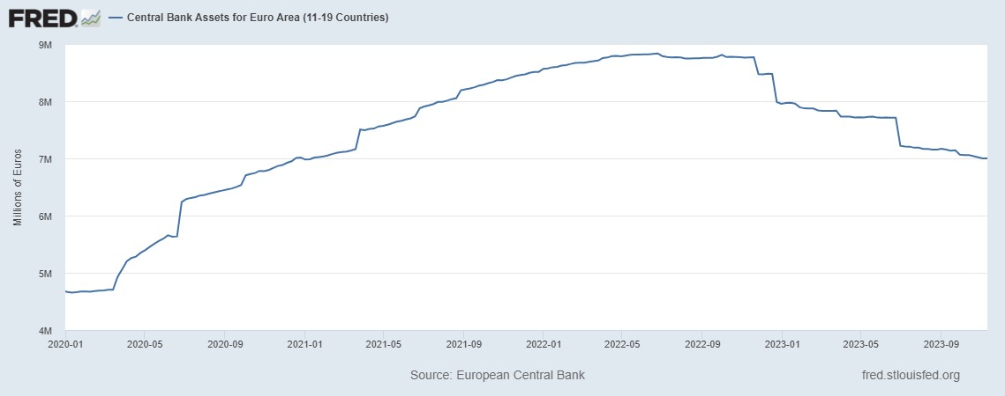
European Central Bank - Balance Sheet – YE 2019 to EOM Oct 2023
Total Assets = EUR 4.7 Trillion as of 12/31/2019 MAX Total Assets: €8.8 Trillion in June 2022 Total Assets = EUR 7.0 Trillion as of 10/31/2023
Trend: Total Assets have increased by 49.6% from pre-pandemic level (end of October 2023) and have been gradually declining since Q4 2022.
ECB assets reached their peak on June 24, 2022 at EUR 8.8 trillion and are now back to the level of January 2021, still higher than the pre-pandemic level.

Slide 14
Target Rates of Return from VC Investments

Slide 15
VC Funds: Performance Metrics
Internal Rate of Return
Multiple of Invested Capital (MOIC)
  Contributions: EUR 200 million
  Distributions: EUR 60 million
  Portfolio value: EUR 160 million
  MOIC = (60+160)/200 = 220/200 = 1.1x
Time to Exit

Slide 16
VC Funds: Reconciliation of Performance Metrics

Slide 17
Some Key Questions
How can we reconcile the “target rate” that managers look for in early stage investments with the “required return” of VC capital investors?
How do the expectations and requirements of VC investors affect a company’s cost of capital/ equity?
How do IRR, MOIC and Time to Exit interact in the evaluation of ESE and fund performance?

Slide 18
Pre- and Post-Money Valuation

Slide 19
Pre-Money and Post-Money Valuation: Example

Slide 20
Notes on Pre-Money and Post-Money Valuation
Post-money Valuation:
        Valuation of a Company after a new financing round has taken place
        Assumptions:
        All shares have equal value
        All equity interests have been converted into common stock
        Calculation: Number of common shares (fully diluted) x unit price of the latest round
Pre-money Valuation:
      Valuation of a Company before a new financing round has taken place
      Calculation: Post-money valuation – Invested Capital (latest round)

Slide 21
Pre-Money and Post-Money Valuation - Key Considerations
Assumption: Liquidation preferences do not affect the allocation of equity value to the various classes/series of shares.
In a complex capital structure, the post-money valuation of a company will typically be higher that the value resulting from a valuation approach that takes into account the liquidation preferences and other economic rights of each class/series of shares.
In a complex capital structure, the cost basis of the latest and most senior round of financing is typically NOT a suitable indication of value for the more junior share classes (common stock, junior preferred).

Slide 22
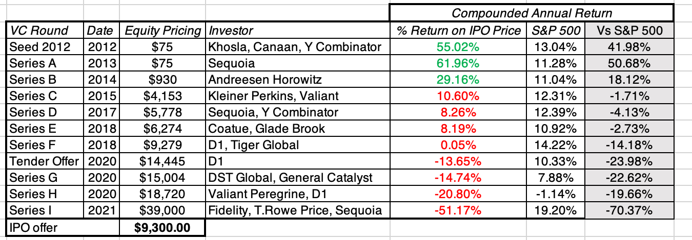
Instacart IPO: Performance by Share Class
Source: A. Damodaran

Slide 23
The Venture Capital Method

Slide 24
The Venture Capital Method
Method for estimating the post-money value of a company and the ownership percentage that an investor may want to target in a new round to achieve its risk-adjusted return objective.
Used extensively in VC deal negotiations
First described by Bill Sahlman of Harvard Business School in 1987

Slide 25
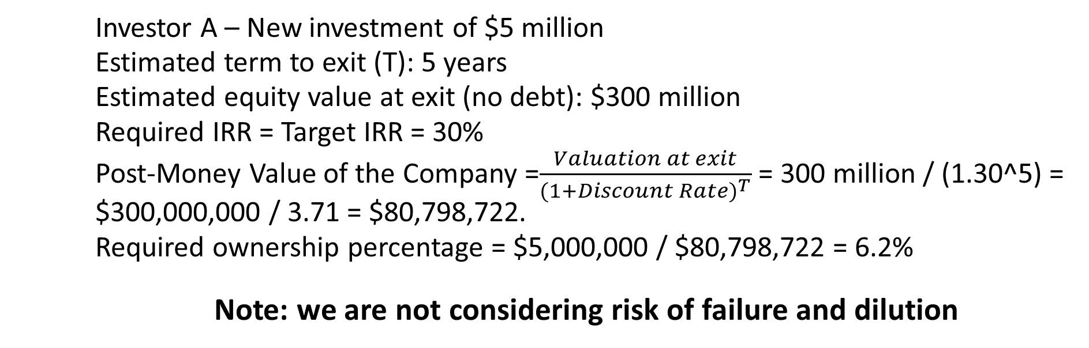
The Venture Capital Method: Base Case Example
    Investor A – New investment of $5 million
    Estimated term to exit (T): 5 years
    Estimated equity value at exit (no debt): $300 million
    Required IRR = Target IRR = 30%
    Post-Money Value of the Company =$\frac{Valuation at exit}{{(1+Discount Rate)}^{T}}$ = 300 million / (1.30^5) = $300,000,000 / 3.71 = $80,798,722.
    Required ownership percentage = $5,000,000 / $80,798,722 = 6.2%
    Note: we are not considering risk of failure and dilution

Slide 26
Venture Capital Method with Dilution and Risk of Failure
  Early stage Company
  $5,000,000 in new funding from Investor
  Investor Required IRR: 20.0% (after dilution and risk of failure)
  Estimated time to exit: 5 years
  Estimated Probability of Failure: 30%
  Estimated Retention Rate: 60%
  What should Investor’s A negotiate as ownership %?

Slide 27
VC Funds: from Target Performance to Negotiated Stake

Slide 28
Asset-Based Approach

Slide 29
Asset Accumulation Method
Asset Accumulation Method:
        Equity value of the Company is equivalent to the fair value of its assets less the fair value of its liabilities
        The fair values of assets and liabilities are estimated using a variety of methods, which often involve a combination of the cost, market and income approaches.
        The AAM concludes a value for the enterprise/equity on a controlling ownership basis
        Different from Book Value = net of the recorded amounts of assets and liabilities under generally accepted accounting principles.
        ESE can be useful:
          in the earliest stages of development, prior to raising arm’s length financing, when there may be limited (or no) basis for using the income or market approaches.
          when intangible assets are the key driver of enterprise valuation and growth and when those assets may be appropriately identified and adequate support can be gathered.
        The AAM requires the identification of assets and liabilities that may be off-balance sheet under current accounting standards, but that may be significant drivers of value.
        The AAM requires a significant amount of detailed information on the company’s operations and of asset-specific information.

Slide 30
Types of Intangible Assets

Slide 31
Intangible Assets: Summary of Valuation Methodologies

Slide 32
Asset Accumulation Method – Adjusted Balance Sheet

Slide 33
WAA-WACC-IRR Reconciliation

Slide 34
DCF Analysis in Early Stage Valuation

Slide 35
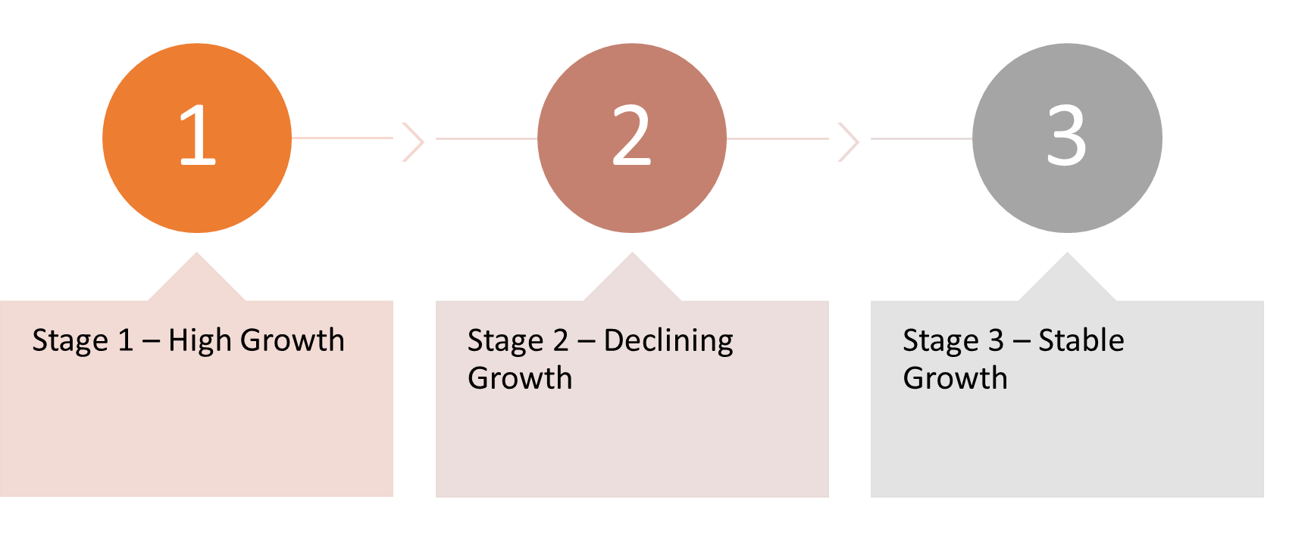
DCF : A Dynamic Model
Requires revenue, path to profitability (not necessarily current profits) and reliable projections
Revenue, Capital Structure, Cost of Capital and Reinvestment vary depending on the stage

Slide 36
DCF: A Dynamic Model - Stage 1
Stage 1 – High Growth
  Revenue growth rates can exceed 40%
  Significant capital investments to expand revenue-generation capacity
  Negative / Low positive profitability
  Angel and Venture Capital investors
  Equity only
  High cost of capital (20%+)
  Initial years of operating losses may require adjustments to the discount rate.

Slide 37
DCF: A Dynamic Model - Stage 2
Stage 2 – Declining Growth
  Revenue growth is still high but declining
  Capital investments are still substantial
  Company is profitable
  Target Exit/IPO may be modelled at this stage
  Company may start issuing debt
  Cost of capital declines

Slide 38
DCF: A Dynamic Model - Stage 3
Stage 3 – Stable Growth
  Company reaches its “mature” stage
  Growth rates in line with long-term trends
  Company is profitable and margins are in line with market
  Capital expenditures are adequate to maintain long-term growth
  Capital structure reflects target structure

Slide 39
Cost of Equity with Modified CAPM
Cost of Equity = RFR + ERP x Beta + SSRP + CSRP
Beta affected by industry, leverage

Slide 40
Market Approach in Early Stage Valuation

Slide 41
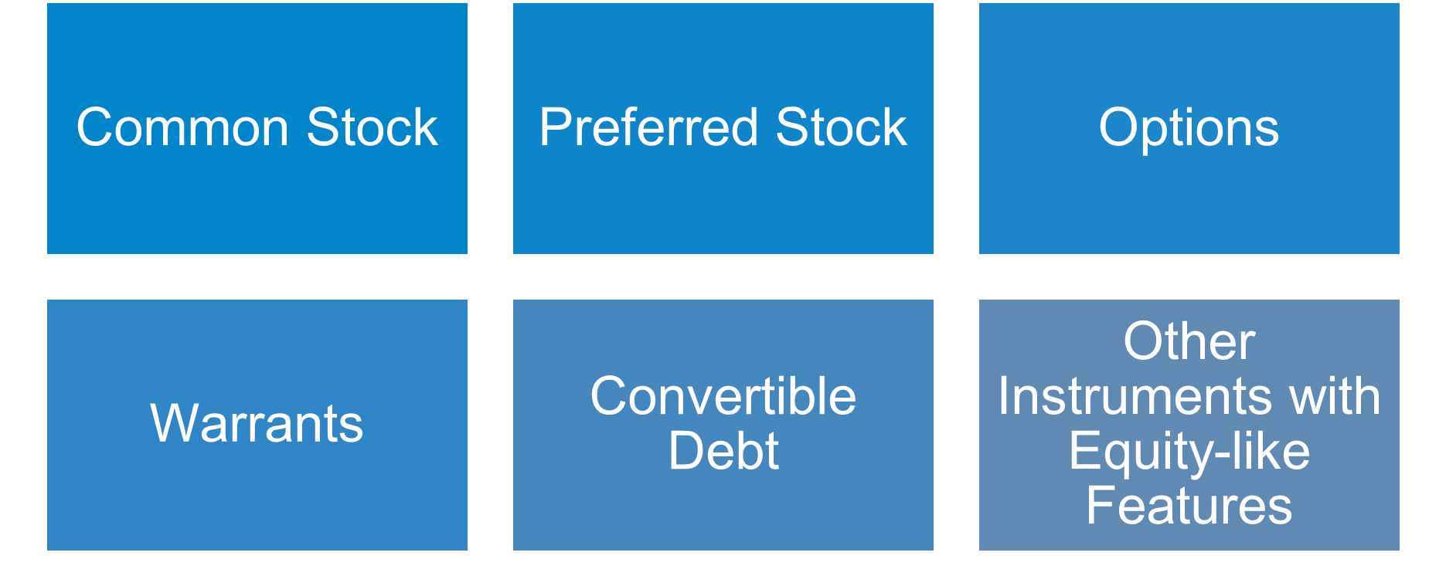
ESE with Complex Capital Structure

Slide 42
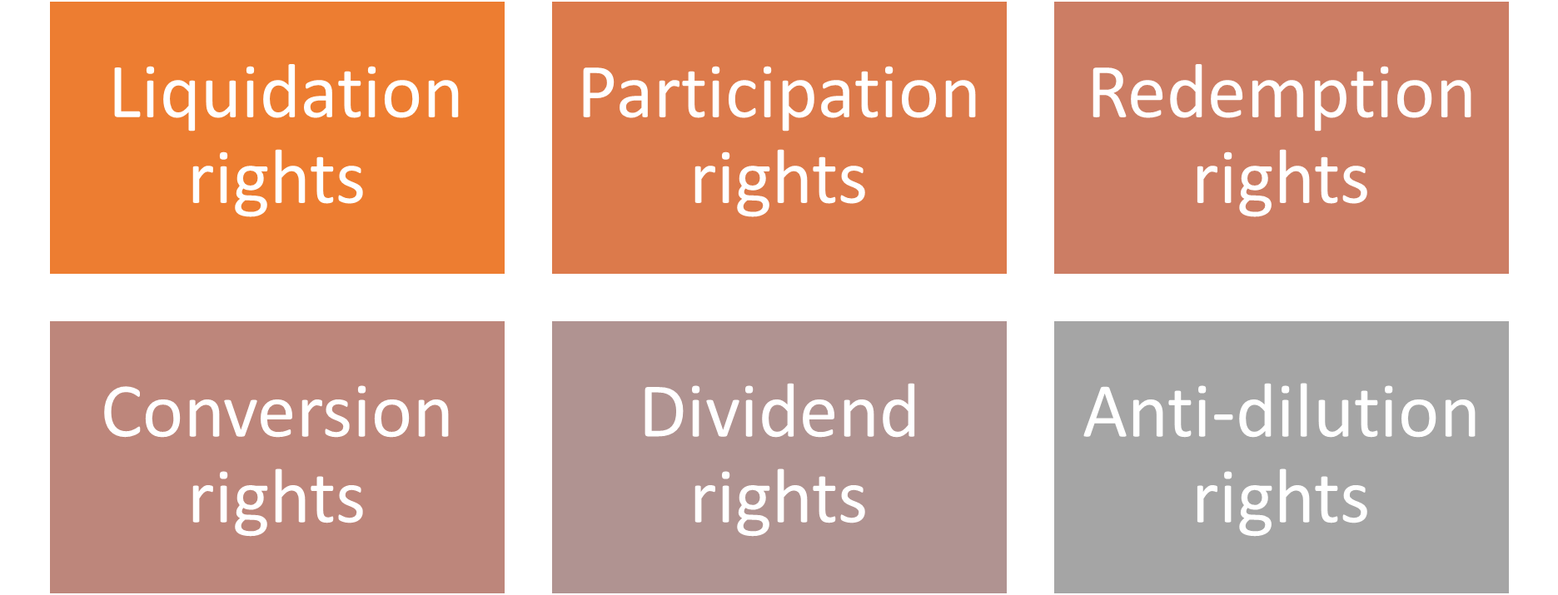
Preferred Stock Rights

Slide 43
Case Study - Sample Company: Capitalization Table
Note: reference to Case Study 10 in AICPA Accounting and Valuation Guide on Valuation of Portfolio Company Investments of Venture Capital and Private Equity Funds and Other Investment Companies

Slide 44
Calibration: AICPA PE/VC Guide
10.12: Calibration is the “process of using observed transactions in the portfolio company’s own instruments, especially the transaction in which the fund entered into a position, to ensure that the valuation techniques that will be employed to value the portfolio company investment on subsequent measurement dates begin with assumptions that are consistent with the original observed transactions as well as any more recent observed transactions in the instruments issued by the portfolio company”.
10.13:” Calibration to the transaction price is required when the initial transaction for an investment represents fair value, and is also used when there are observed transactions in the portfolio company’s instruments at later dates”
Calibration allows to extract key unobservable inputs (IRR, market multiples) used by VC investors from infrequent portfolio company’s transactions.

Slide 45
“A method within the market approach wherein the equity value for a privately held company is derived from a recent transaction in the company’s own instruments. […] Management first estimates the other assumptions used within a valuation model, and the remaining assumption (total equity value) is then inferred from the transaction price”
[AICPA PE/VC Guide Glossary]
“When the price of the initial investment in an Investee Company or instrument is deemed Fair Value, which is generally the case if the entry transaction is considered an Orderly Transaction then the Valuation techniques that are expected to be used to estimate Fair Value in the future should be evaluated using market inputs as of the date the Investment was made. This process is known as Calibration. [IPEV Guidelines Par. 2.6]
Backsolve
Method

Slide 46
Under the OPM Backsolve, each class/series of stock is modelled as a set of call options on the company’s equity value
Call options give to the holder the right, but not the obligation, to buy an underlying asset (the equity value of the enterprise in this case) at a certain price over a certain period of time.
For a company that has preferred and common stock in its capital structure, the payoff to common stock shareholders is effectively equal to that of the owner of a call option (or set of options) on the company’s equity value, with a strike price equal to the liquidation preference of preferred stock, and a term that coincides with the projected time to exit of the investment in the company.
Option Pricing Model and Backsolve Method

Slide 47
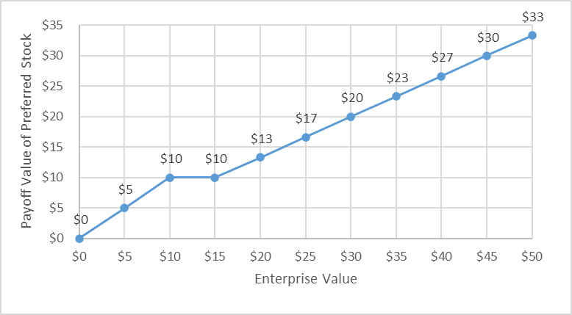
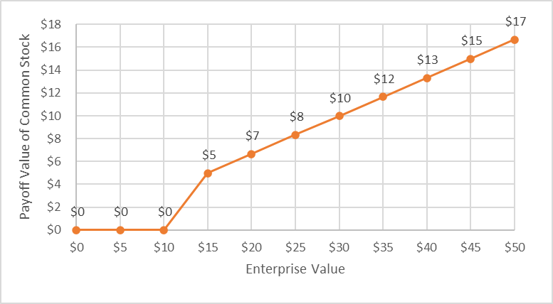
Payoff of Preferred and Common Stock at Exit

Slide 48
Backsolve OPM: starts from “known” value of unit of preferred stock (based on transaction price) and back-solves to enterprise value using the OPM, given:
  Volatility of equity value: typically based on guideline companies
  Exercise price = breakpoint
  Term = expected timing of a liquidity event
  Risk-free rate = based on U.S. Treasury securities with matching Term
  Dividend yield = typically zero (no expectation to pay dividends prior to liquidity event)
Option Pricing Model and Backsolve Method
(continued)

Slide 49
OPM Breakpoints
Exercise prices (Breakpoints): Future enterprise values at which there are changes in the distribution of proceeds among the various equity classes, including preferred stock, common stock, options and warrants.

Slide 50
OPM Backsolve Method at Calibration

Slide 51
Are there new investors involved?
Are the founders involved?
Is there an element of compensation?
Is the transaction between related parties?
Is the transaction for a single class of securities or a bucket of securities?
Does the transaction take place in orderly market conditions?
Is the
Reference Transaction
at Fair Value?

Slide 52
Subsequent Measurement: 1 Year Later
Equity value of $22 million is now an input
Time to exit: 2y
Volatility: 80%
RFR: 4.5%

Slide 53
Sample Valuation Summary for a PE/VC Portfolio Company

Slide 54
Some
Takeaways
Early Stage Enterprises may include companies of $1b+ in valuation
VC performance should consider IRR, MOIC and Time to Exit
Connection between VC required returns and cost of capital
“Vision” of the company and its development over time
OPM Backsolve: Flexible tool based on actual transactions
DCF: consider multi-stage model
Consider differences in volatility among share classes/series

Slide 55
Questions?

Slide 56
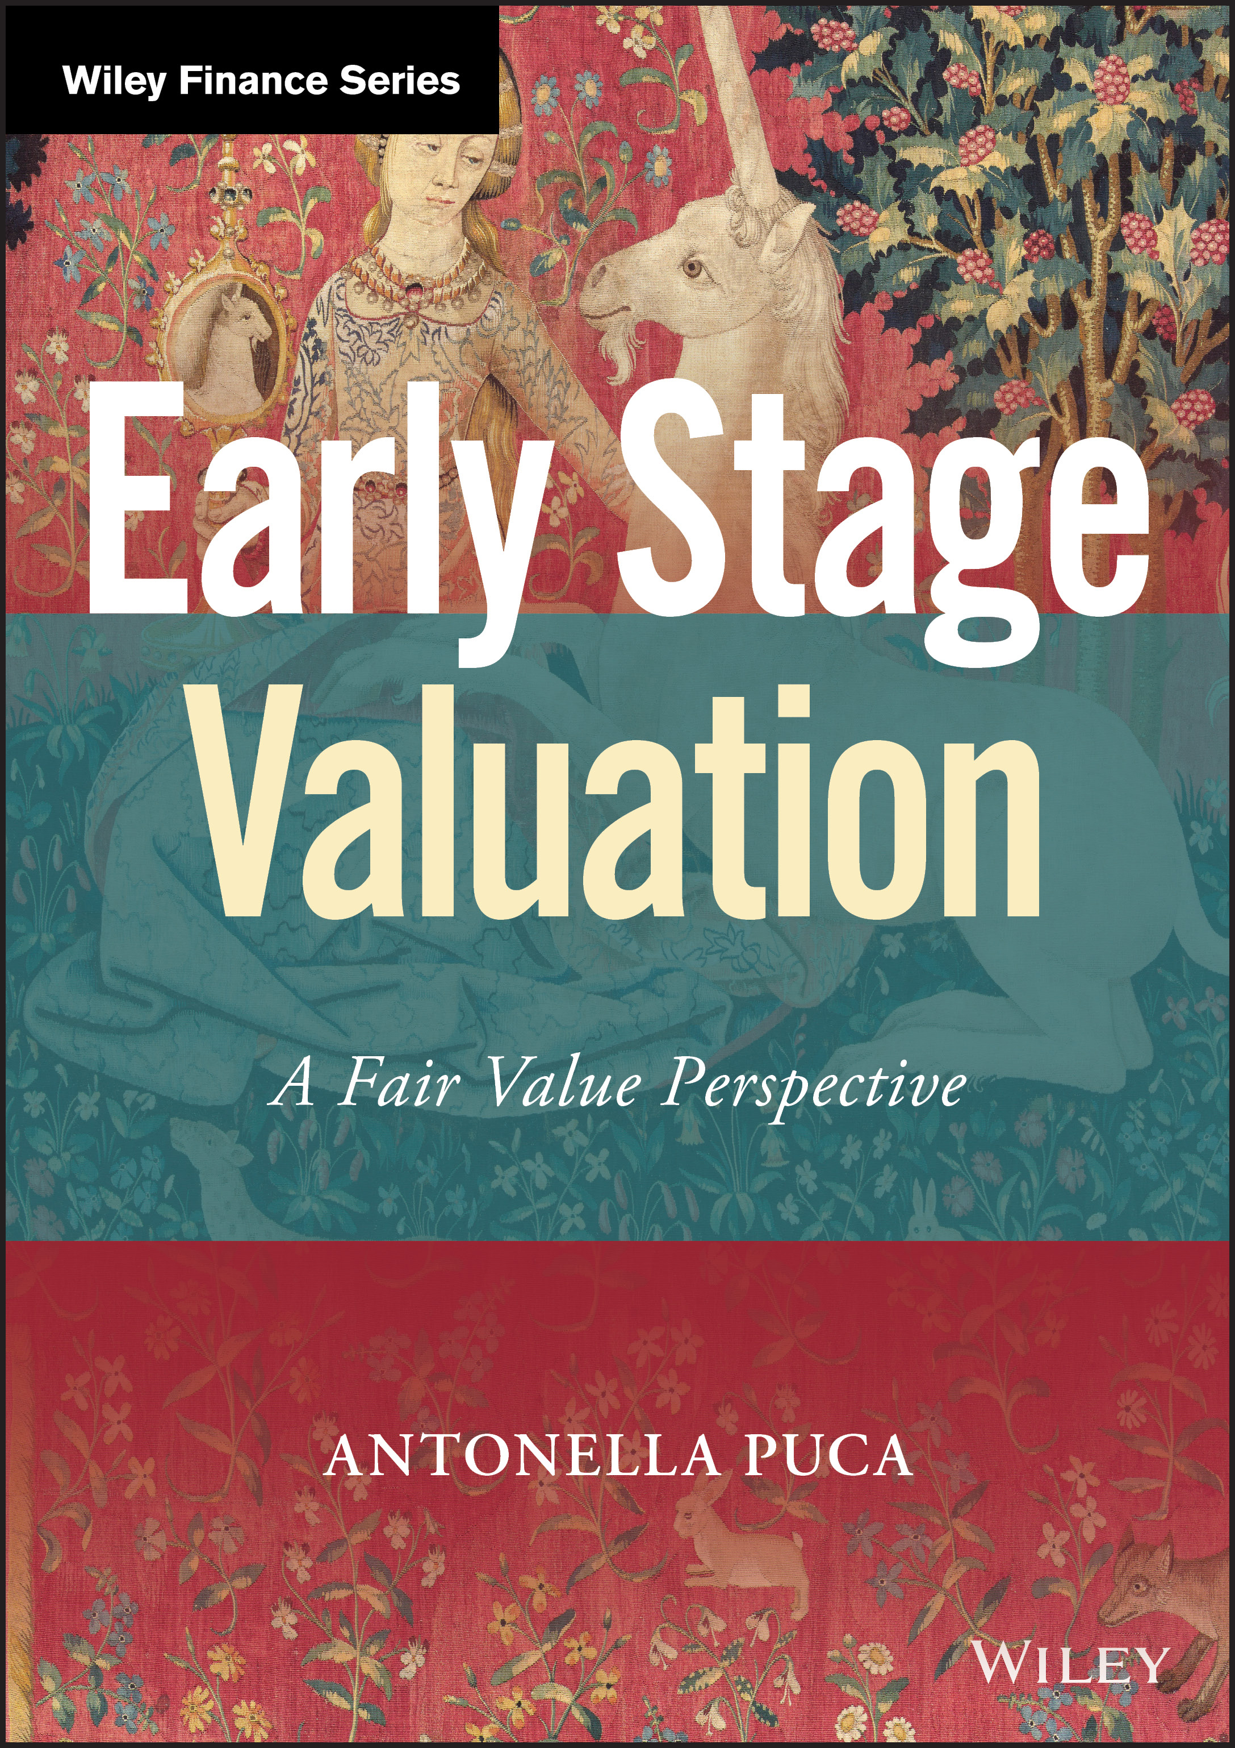
Thank you!
Antonella Puca, CPA/ABV, CFA
apuca@blueval-global.com
+1-212-920-4398

